Slide 1
Programmable Logic Controller Mrs. Meera Ajit Khandekar Department of Instrumentation & Control College of Engineering, Pune

Slide 2
Learning Objective:
Students will be able to understand PLC operation
Students will be able to understand types input/output module of PLC
Students will be able to understand PLC instructions.

Slide 3
Types of System
Discrete Process
Continuous Process

Slide 4
Advantages
Cost effective for controlling complex systems.
Flexible and can be reapplied to control other systems quickly and easily.
Computational abilities allow more sophisticated control.
Trouble shooting aids make programming easier and reduce downtime.
Reliable components make these likely to operate for years before failure.

Slide 5
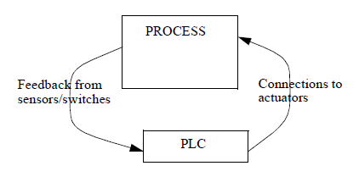
Controller and Process

Slide 6
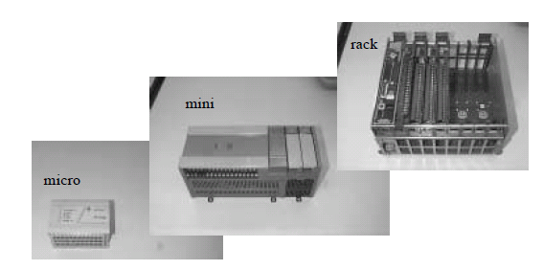
Typical Configurations for PLC

Slide 7
PLC configurations
Rack - A rack is often large (up to 18” by 30” by 10”) and can hold multiple cards. When necessary, multiple racks can be connected together. These tend to be the highest cost, but also the most flexible and easy to maintain.
Mini - These are similar in function to PLC racks, but about half the size.
Shoebox - A compact, all-in-one unit (about the size of a shoebox) that has limited expansion capabilities. Lower cost, and compactness make these ideal for small applications.
Micro - These units can be as small as a deck of cards. They tend to have fixed quantities of I/O and limited abilities, but costs will be the lowest.
Software - A software based PLC requires a computer with an interface card, but allows the PLC to be connected to sensors and other PLCs across a network.

Slide 8
PLC essential components
Power Supply - This can be built into the PLC or be an external unit. Common voltage levels required by the PLC (with and without the power supply) are 24Vdc, 120Vac, 220Vac.
CPU (Central Processing Unit) - This is a computer where ladder logic is stored and processed.
I/O (Input/Output) - A number of input/output terminals must be provided so that the PLC can monitor the process and initiate actions.
Indicator lights - These indicate the status of the PLC including power on, program running, and a fault. These are essential when diagnosing problems.

Slide 9
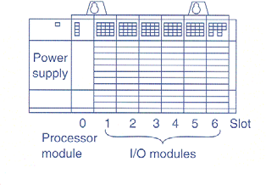
Power Supply
unaddressed (not
typically part of
rack)
Processor in slot 0
I/O in non-zero slots

Slide 10
Type
File Type
I for Input File
O for Output File
Others covered latter
Slot
Rack Number
Slot Number
Word or Bit
Identifies the actual terminal connection
Discrete module use one word and thus number specifies bit
Address Elements

Slide 11
Actuators
Solenoid Valves - logical outputs that can switch a hydraulic or pneumatic flow.
Lights - logical outputs that can often be powered directly from PLC output boards.
Motor Starters - motors often draw a large amount of current when started, so they require motor starters, which are basically large relays.
Servo Motors - a continuous output from the PLC can command a variable speed or position.

Slide 12
Inputs
Proximity Switches - use inductance, capacitance or light to detect an object logically.
Switches - mechanical mechanisms will open or close electrical contacts for a logical signal.
Potentiometer - measures angular positions continuously, using resistance.
LVDT (linear variable differential transformer) - measures linear displacement continuously using magnetic coupling.

Slide 13
Common Discrete I/O Ratings
Input | Output
24 VAC | 12-48 VAC
48 VAC | 120 VAC
120 VAC/VDC | 230 VAC
230 VAC/VDC | 120 VDC
5 VDC (TTL Levels) | 5 VDC (TTL Levels) 24 VDC

Slide 14
Input Module
Input Module sense when a signal is received from a sensor on the machine
Input Module convert the input signal to the correct voltage level for the particular PLC
Input Module isolate the PLC from fluctuations in the input signal’s voltage and current
Input Module send a signal to the PLC indicating which sensor originated the signal

Slide 15
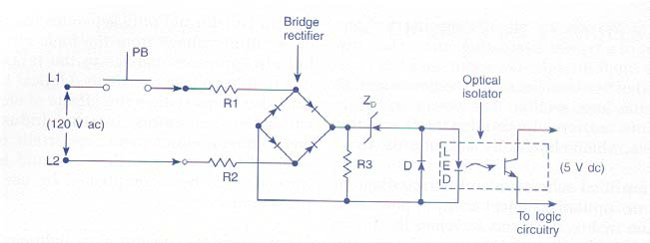
AC input Circuit Module

Slide 16
Output Module
Output interface module of a PLC acts as a switch to supply power from the user power supply to operate the output.
Output switching devices most often used to switch power to the load in PLC
Relay for ac or dc load
Triac for ac loads only
Transistors for dc loads only

Slide 17
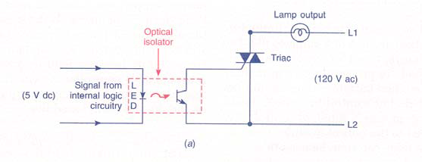
AC Output Circuit

Slide 18
Analog input interface modules contain the circuitry necessary to accept analog voltage and current signals from analog field devices.
These signals are converted from an analog to a digital value by an ADC
Analog input sensing devices include temperature, light, speed, position transducer etc.

Slide 19
Analog output interface module receive digital data from the processor that is converted into a proportional voltage or current to control an analog field devices
The digital data is passed through a DAC to produce the necessary analog form.
Analog output devices include small motors, valve etc.

Slide 20
Each port or terminal on input and output modules is assigned a unique address number.
The location of the module within a rack and the terminal number of a module to which an input or output device is connected will determine the address of the device.

Slide 21
Special I/O Modules
High-Speed Counter Module
Thumb-Wheel Module
TTL Module
Encoder-Counter Module
BASIC or ASCII Module
Stepper-Motor Module
BCD-Output Module
PID Module
Servo Module
Communications Module
Language Module
Speech Module

Slide 22
I/O Specifications
Nominal Input Voltage
On-State Input Voltage Range
Nominal Current per Input
Ambient Temperature Rating
Input Delay
Nominal Output Voltage
Output Voltage range
Maximum Output Current Rating per Output and Module

Slide 23
I/O Specifications
Maximum Surge Current per Output
Off-State Leakage Current per Output
Electrical Isolation
Number of Inputs and Outputs per Card
Backplane Current Draw
Resolution
Input Impedance and Capacitance
Common Mode Rejection Ratio

Slide 24
Sinking - When active the output allows current to flow to a common ground. This is best selected when different voltages are supplied.
Sourcing - When active, current flows from a supply, through the output device and to ground. This method is best used when all devices use a single supply voltage.
This is also referred to as NPN (sinking) and PNP (sourcing). PNP is more popular.

Slide 25
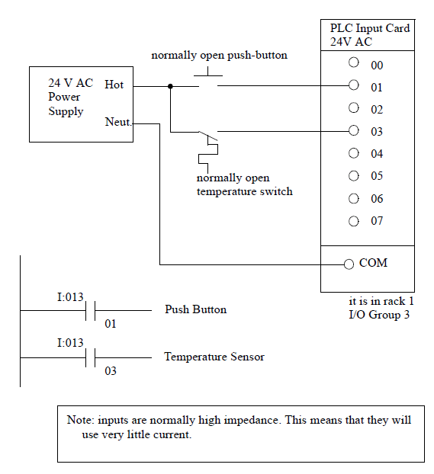
Typical Configurations for PLC

Slide 26
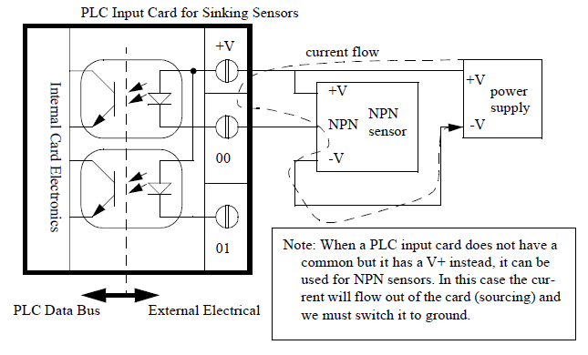
A PLC Input Card for Sinking Sensors

Slide 27
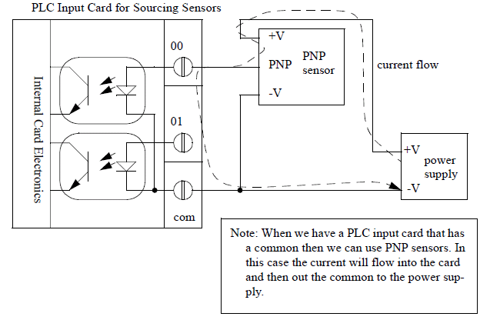
PLC Input Card for Sourcing Sensors

Slide 28
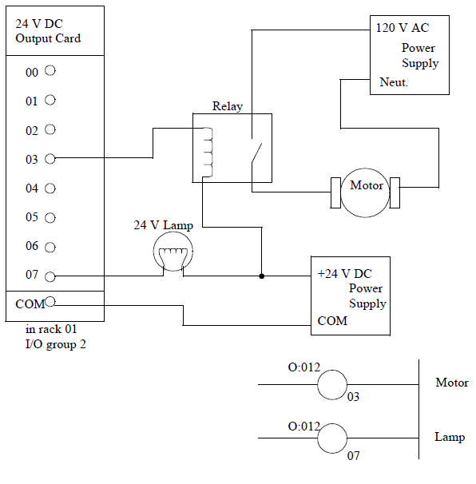
A 24Vdc Output Card (Sinking)

Slide 29
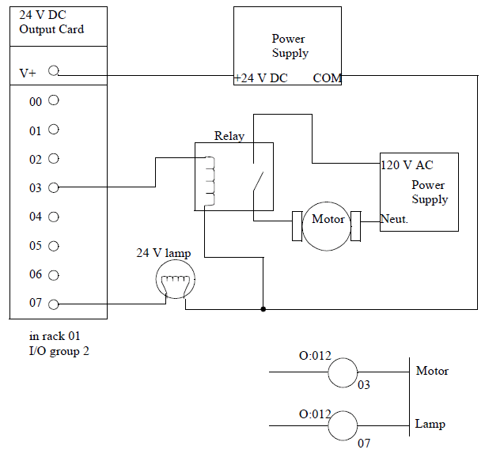
24Vdc Output Card With a Voltage Input (Sourcing)

Slide 30
To operate the program, the controller is placed in RUN mode.
During RUN operation inputs are examined and their status is recorded in the controller’s memory.
If these contacts provide current path from left to right in the diagram, the output coil memory location is given a logic 1 value and the output module interface contact will close.
If there is no conducting path on the program rung, the output coil memory location is set to logic 0 and output module interface contact will be open.
The completion of one cycle of this sequence by the controller is called a scan.
The scan time, provide a measure of the response of the PLC.

Slide 31
PROGRAM mode is used to enter a new program or update an exiting one in the internal RAM memory.
TEST mode is used to operate or monitor the user program without energizing any outputs

Slide 32
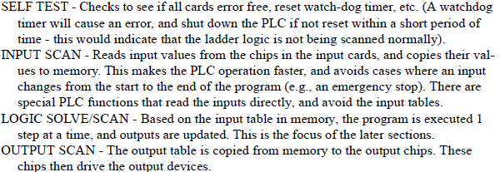
PLC Scan Cycle

Slide 33
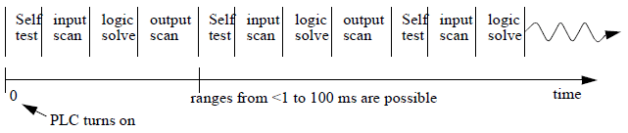
PLC Scan Cycle

Slide 34
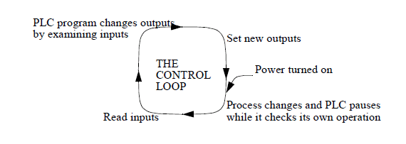
Scan Cycle of a PLC

Slide 35
IEC 61131 is an international standard for PLCs formulated by the International Electrotechnical Commission (IEC)
Ladder diagram (LD)
Sequential Function Charts (SFC)
Function Block Diagram (FBD)
Structured Text (ST)
Instruction List (IL)

Slide 36
Control Program Architecture with SFCs
Each step and transition in the SFC of the main program block is coded as a module
These modules may be coded using any of the languages under the 1131-3 standard.

Slide 37
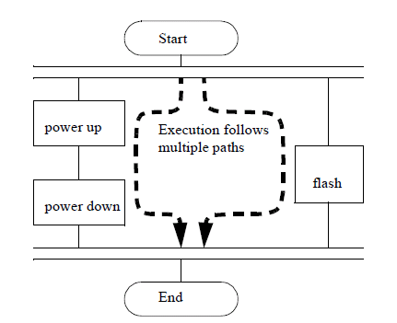
Sequential Function Charts (SFCs)

Slide 38
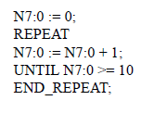
Structured Text Program

Slide 39
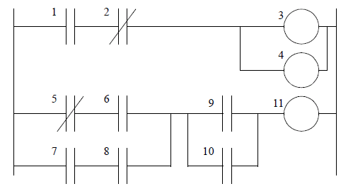
Ladder Logic Execution Sequence

Slide 40
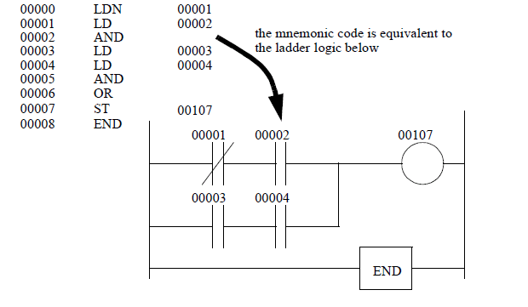
Mnemonic Program and Equivalent Ladder Logic

Slide 41
Seven step sequence for development and implementation of logic:
Development of block diagram or P&ID (Piping and Instrumentation Diagram).
Listing of input and output devices
Development of a flow chart of the process
Developing a cause and effect diagram
Actual development of logic (ladder logic)
Validation of logic on simulators; debugging, safety interlocks
Actual execution; optimization

Slide 42
NO Push Button as an Input to a PLC
A normally open field input device will input a binary 0 to input status file bit position.
When programming normally open(Examine if closed), instruction examines input status file for an ON condition.
In this example the processor detects a binary 0 in the status file address and the instruction is false
Since this instruction is false, 0 will be placed in the output status file bit position for this rung’s output instruction.

Slide 43
When programming normally closed(Examine if open) instruction, the processor is testing to see if the instruction is open.
If the processor finds an OFF condition, the examine if open instruction is true.
When the PLC up-dates outputs, Output will energize.

Slide 44
NC push button interface to the PLC
Normally closed input device sends 1 to input status file bit position.
The normally open contact instruction on this rung will be energized.
If you program a normally open(Examine if closed) instruction for the normally closed input stop push button, the examine if closed instruction will be true.
With examine if closed instruction, the output will be true.

Slide 45
If you program a normally closed(Examine if open) instruction, the processor is testing to see if the instruction is open.
If the normally closed(Examine if open) instruction examines the PLC input status file and the processor finds a binary 1 condition, the normally closed(Examine if open) instruction is false
When the PLC updates outputs, the output will not energise.

Slide 46
Timer
An on-delay timer will wait for a set time after a line of ladder logic has been true before turning on, but it will turn off immediately.
Consider the example of an old car. If you turn the key in the ignition and the car does not start immediately, that is an on-delay.
An off-delay timer will turn on immediately when a line of ladder logic is true, but it will delay before turning off.
If you turn the key to stop the engine but the engine doesn’t stop for a few seconds, that is an off delay.

Slide 47
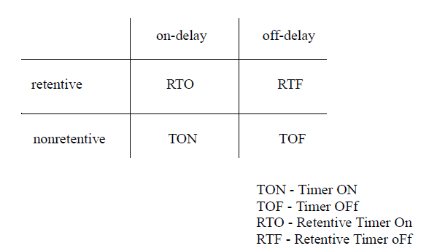

Slide 48
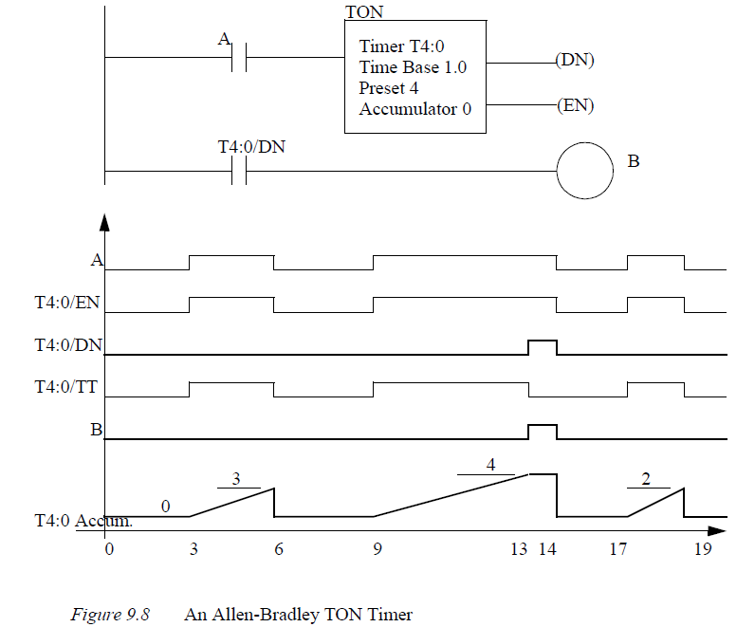

Slide 49
Control Word:
The control world uses three bits: the enable bit(EN), the timer-timing bit(TT), and the done bit(DN).
The enable bit is true(has status of 1) whenever the timer instruction is true.
The timer-timing bit is true whenever the accumulated value of the timer is changing, which means timer is timing.
Preset word: is the set point of the timer
Accumulated Word: incrementing as the timer is timing. The accumulated value will stop incrementing when its value reaches the preset value.

Slide 50
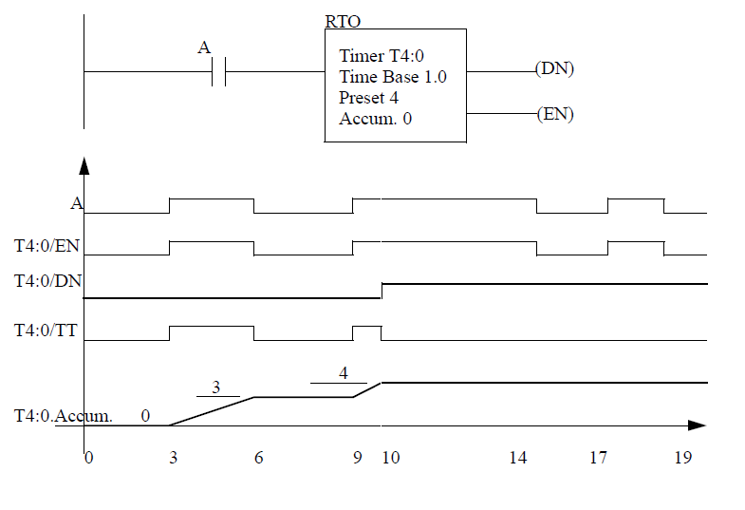

Slide 51
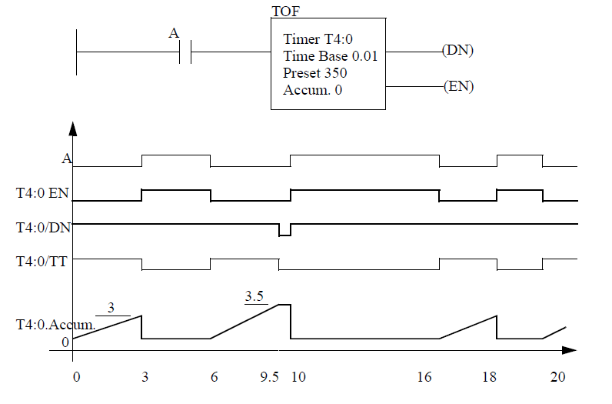

Slide 52
Fail-safe Design
NO (Normally open) - When wiring switches or sensors that start actions, use normally open switches so that if there is a problem the process will not start.
NC (Normally Closed) - When wiring switches that stop processes use normally closed so that if they fail the process will stop. E-Stops must always be NC, and they must cut off the master power, not just be another input to the PLC.

Slide 53
Thank you!

